Slide 1
FlexFit Health - Activity & Wellness Analysis
- A Case Study by Anik Chakraborty

Slide 2
🎯 Objective
Analyze and interpret FlexFit Health’s wearable activity data to uncover actionable insights that drive user engagement, product optimization, and wellness outcomes.
Project Purpose:
Assess how active users are across months and activity types.
Identify engagement patterns based on distance, minutes, and calories burned.
Provide insights to improve user motivation and fitness app performance.
Key KPIs:
Total Users: 33
Total Duration: 11 Months
Average Calories Burned: 2.30K
Average Steps: 7.64K
Average Active Minutes: 227.54
Untracked Distance: 13.49 Km
Active Days: 864 | Inactive Days: 76
Deliverables:
Interactive Power BI dashboard showing user activity & wellness patterns.
Detailed analysis on engagement trends and activity performance.

Slide 3
📘 Project Overview
Context Highlights :
The analysis helps FlexFit Health’s marketing, R&D, and product teams understand:
How users engage with fitness trackers
Which neighborhoods are most active
Relationships between steps, calories, and active minutes
How activity varies by age, location, and time
Using Excel, Power Query, and Power BI, the project transforms raw activity data into an interactive dashboard that visualizes key metrics and trends — driving data-informed wellness strategies and enhanced user engagement.

Slide 4
🗂️ Data Overview & Schema
Data Source:
Source: Fictionalized fitness tracking dataset provided by FlexFit Health.
Data Type: Structured user profiles and daily activity logs captured via FlexFit smart devices.
Time Period: Continuous daily activity tracking snapshot for the year 2016.
Data Structure & Metrics:
Key Index Types: User-level records in the User Details dataset and date-level activity logs in the Activity dataset.
Total Rows: Users – 58, Activity Logs – ~10,000+.
Categories: Around 15+ features across three main segments:
Demographics: First Name, Last Name, Age, Address, Neighborhood, Date
Performance Indicators: Total vs. Tracker Distance, Logged Activity Distance, and Active Minutes split
Calculated Metrics: Derived fields using custom DAX measure for Power BI insights.
Activity metrics: Steps, Distance, Active Minutes (Light, Fairly, Very)
Derived metrics: Total Calories Burned, Engagement Level, Tracker Distance, Untracked Distance, Total Active Time, Activity Intensity Score

Slide 5
💻 Tech Stack
Tools:
Excel
Data cleaning & preprocessing
PowerQuery
ETL transformations
PowerBI
Visualization, DAX measures & dashboard design
DAX – Calculated measures and time intelligence
PowerPoint
Presentation and final dashboard snapshots

Slide 6
📈 Methodology & Analysis
Preparation, Process & Analytical Approach:
Data Preparation & Cleaning:
Handled missing and inconsistent activity logs.
Standardized numeric fields and validated record accuracy.
Merged datasets via User ID to build a unified analytical model.
Data Modeling & Integration:
Established User → Date → Activity relationships.
Ensured one-to-many integrity (1 user → many activity records).
Feature Engineering:
Derived new measures: Active Minutes, Engagement Type, and Untracked Distance.
Split Address → Neighborhood using Power Query for location insights.
Visualization Design:
Built two interactive dashboards:
Engagement Overview
Activity Performance
Applied synchronized slicers for Age Group, User, and Timeframe filters.
Data Validation & Formatting:
Verified data consistency across all relationships.
Standardized date formats, distance units (KM), and column names for Power BI readiness.

Slide 7
❓ Problem Statement
FlexFit Health, a next-generation fitness technology company, provides smart wearables that track users’ daily movements, calories burned, and overall activity levels.
This project analyzes daily user-level activity data from New York City residents (Brooklyn & Manhattan) over an 11-month period to explore user engagement, fitness behaviors, and wellness outcomes.
Key Questions:
How active are users across different months and age groups?
Which users show the highest calorie burn and active minutes?
What is the monthly trend of engagement levels?
How much of total distance remains untracked?

Slide 8
💡 Key Insights
Top Findings:
April shows highest activity & calorie burn among all months.
Young Adults (27.45%) are the most engaged demographic.
Untracked Distance: ~13.49 Km — indicates device off-time or missing syncs.
Active Minutes & Distance strongly correlate with higher engagement levels.
Few users (e.g., Michael Brown, Andrew Garcia) dominate activity metrics.
Supporting Metrics:
Monthly average active minutes gradually decline from May–December.
Low engagement spikes during months of reduced activity tracking.

Slide 9
📍Conclusion
Summary:
User activity patterns show that engagement and consistency fluctuate across months and age groups. While a few users maintain strong calorie burn and active minutes, overall participation is highly seasonal.
Improving data tracking accuracy, encouraging steady user engagement, and tailoring personalized fitness goals can significantly enhance activity outcomes and platform adoption.
The analysis highlights that smart insights from wearables can empower both users and health teams — driving informed decisions that promote healthier, more active lifestyles.

Slide 10
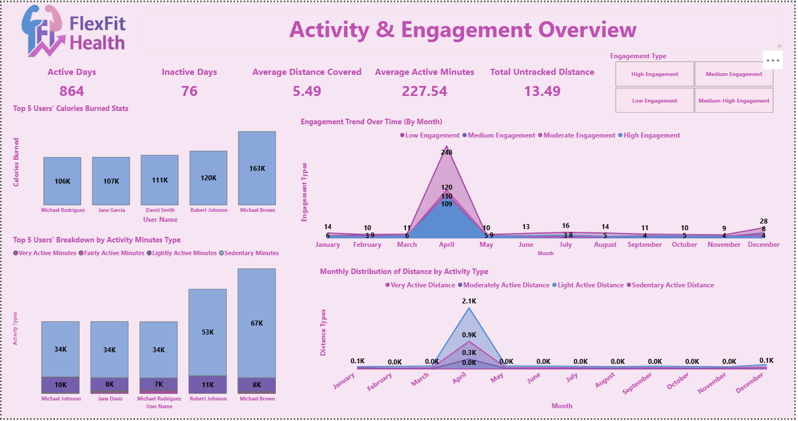
🖥️ Dashboard Overview (1) – Activity Performance

Slide 11
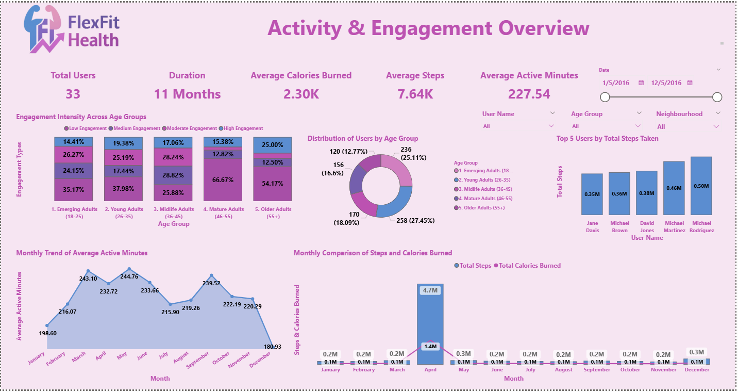
🖥️ Dashboard Overview (2) – Engagement Overview

Slide 12
✅ Business Impact & Use Cases
Enables fitness app designers to personalize activity goals and challenge levels based on user behavior trends.
Assists health analysts in identifying underperforming users and tailoring interventions for better wellness outcomes.
Helps marketing teams target users with low engagement levels through data-driven retention campaigns.
Supports product teams in enhancing engagement features such as streak tracking, goal reminders, and performance badges.
Guides R&D teams to understand device usage and improve sensor accuracy or battery optimization.
Allows business strategy teams to measure the impact of product adoption by neighborhood and demographic segment.
Provides leadership with a comprehensive view of user engagement KPIs to drive data-informed decision-making.

Slide 13
🙏 Acknowledgement & Contact
Project Analyst: Anik Chakraborty 📧 Email: anikc1710@gmail.com
Special Thanks To:
Coding Ninjas – for project framework and guidance
Connect: 🔗 GitHub | 🔗 LinkedIn

Slide 14
Thank You!

